Slide 1
Sales Dashboard Report with Insights
Title: Sales Performance Dashboard Report
Subtitle: Analysis of Sales, Territories, Products, and Trends (2011–2014)
Footer: Generated: August 23, 2025

Slide 2
Agenda
Sql View
Modling
Overview
Sales by Territory
Product Details
Date-Based Trends
Key Insights and Recommendations

Slide 3
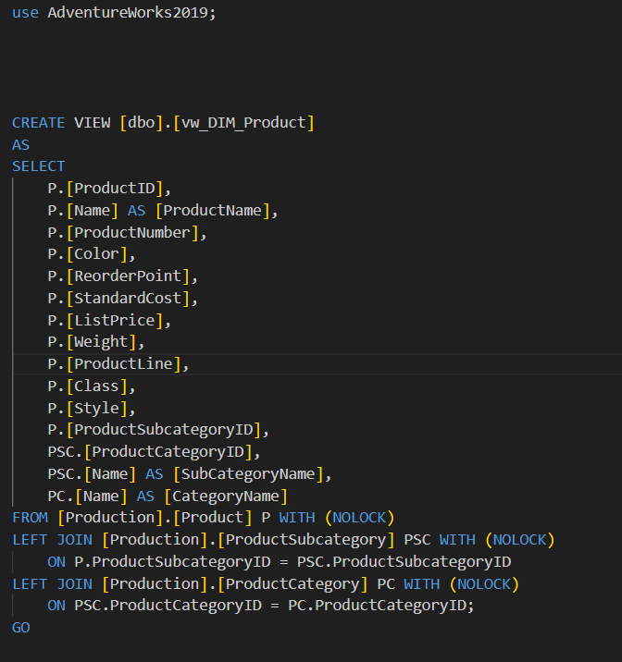
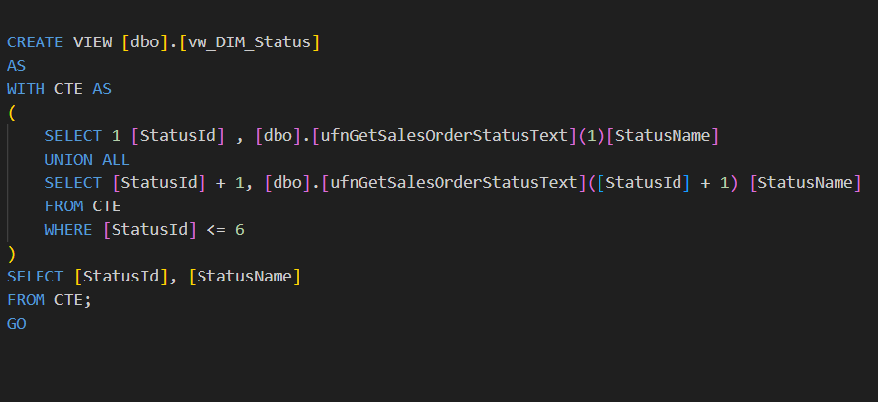
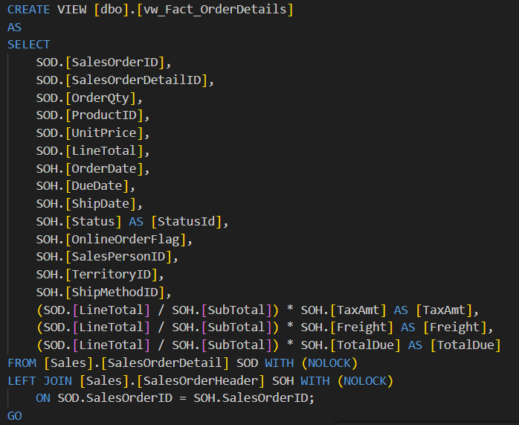
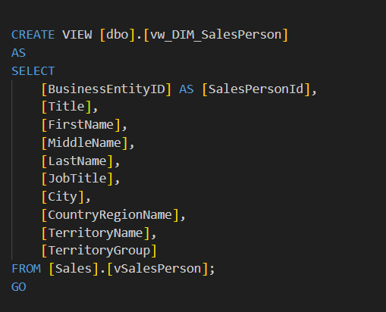
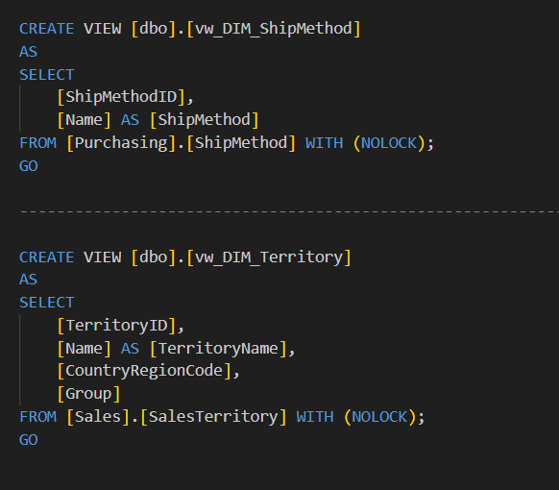
Sql Views

Slide 4
Overview - KPIs and High-Level Summary
KPIs (Text Boxes with colors/icons):
Total Sales: $XX,XXX (Green if > benchmark)
YTD Sales: $XX,XXX
YoY Growth: X% (Green up arrow if >10%, Red down if <0)
On-Time Delivery: X% (Yellow if <90%)
Bar Chart: Sales by Category
Insight: Bikes lead sales, contributing ~60% of total revenue, followed by Components. Drill-down in Power BI reveals top subcategories like Road Bikes.
Line Chart: YTD Sales over Time
Insight: Sales peak mid-year, with a rolling 3-month average smoothing seasonal fluctuations. Tooltips show monthly growth trends.
Table: Top 5 Salespersons
Columns: Salesperson, Total Sales (e.g., Stephen Y Jiang: $X,XXX)
Insight: Top performers drive significant revenue, with Stephen Y Jiang leading. Use Power BI filters to analyze by territory or year.

Slide 5
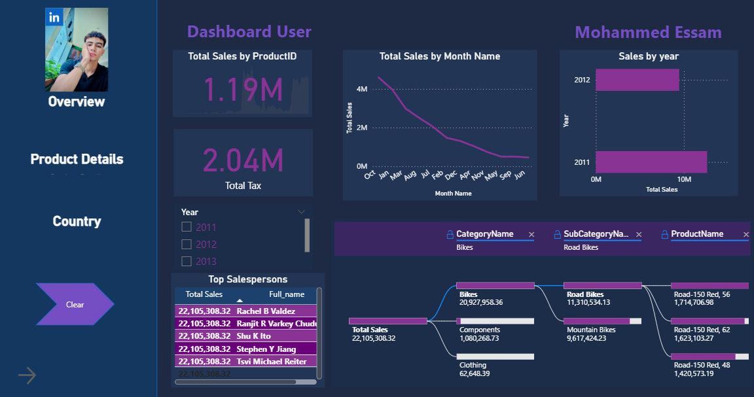
Overview

Slide 6
Product Details
Donut Chart: Sales by Category
Insight: Bikes account for the majority of sales, followed by Components. Drill-through in Power BI filters to specific products.
Stacked Bar Chart: Sales by ProductName, grouped by Color
Insight: Products like HL Road Frame lead in sales, with Black and Red colors preferred. Analyze by color for inventory planning.
Scatter Plot: ListPrice vs Weight
Insight: Higher-priced products (e.g., Road Frames) drive larger sales volumes, despite varying weights. Use Power BI to filter by category.
KPIs: Avg Order Value: $X.XX | Product Margin: X%
Insight: Margins vary by category; Clothing has lower margins. Monitor low-margin products for cost optimization.

Slide 7
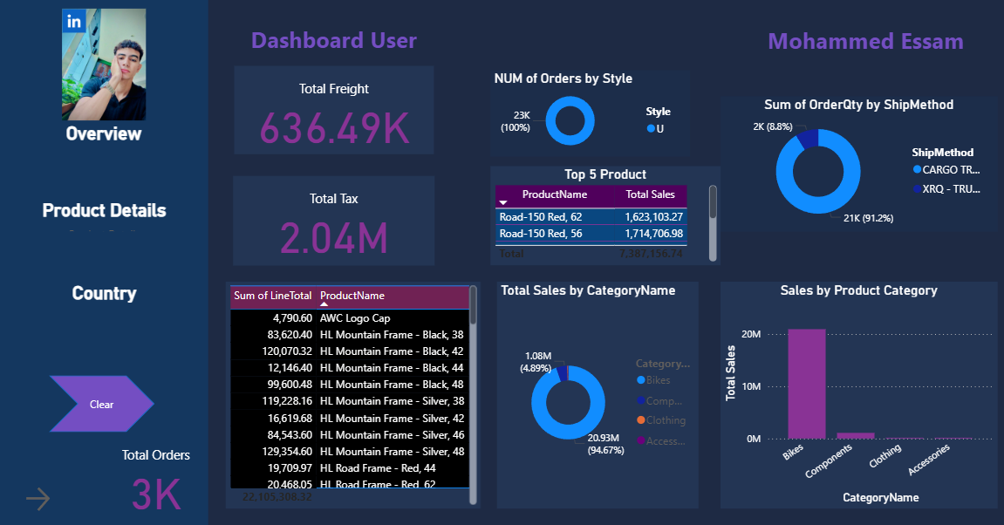
Product Detials

Slide 8
Sales by Territory/ Country Page
Map: Sales by CountryRegionCode
Insight: North America dominates sales, with the US leading. High growth in Northwest territory; hover in Power BI for salesperson details.
Clustered Column Chart: Sales by Territory Hierarchy
Insight: Drill-down from Group (e.g., North America) to Territory (e.g., Northwest) shows regional performance. Southwest shows strong growth.
Matrix: Quarterly Sales by Territory
Insight: Q3 consistently outperforms other quarters across territories. Conditional colors highlight top performers (green) vs underperformers (red).

Slide 9
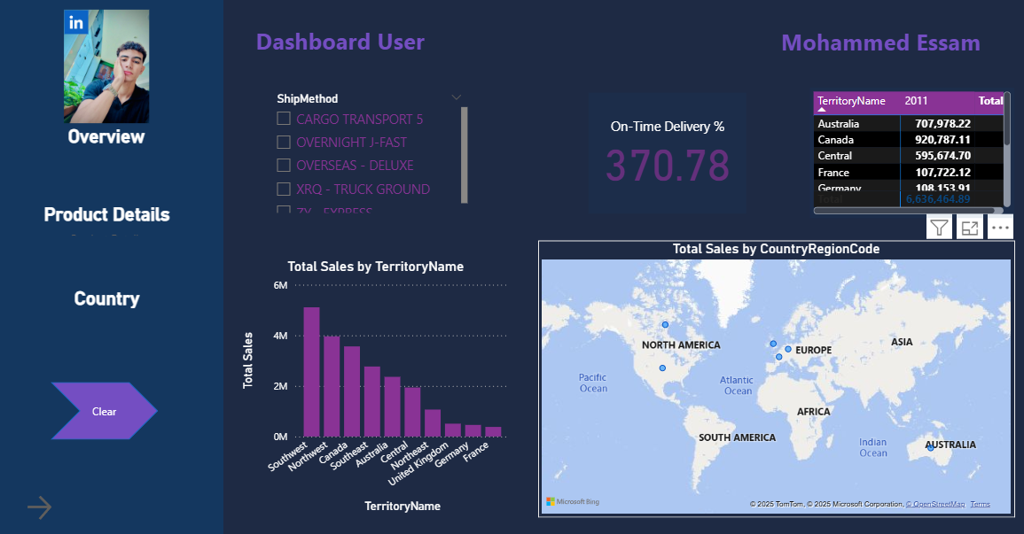
Country

Slide 10
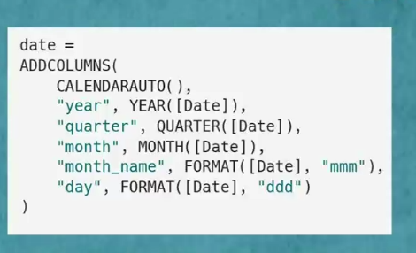
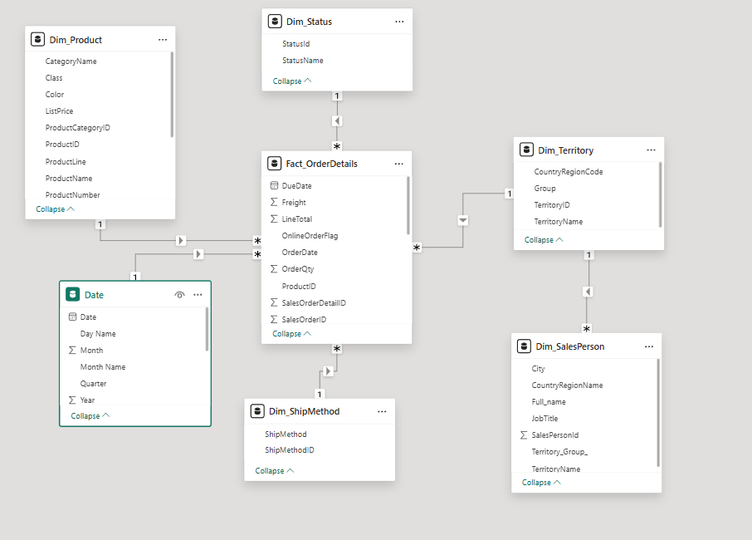
MoDLING

Slide 11
Date Analysis
Line/Column Chart: Sales and Orders over Time
Insight: Sales and order volumes peak in Q3 each year. Use Date Hierarchy in Power BI to drill down to daily trends.
Area Chart: MoM Growth %
Insight: Month-over-month growth fluctuates, with positive trends in mid-year. Negative growth in Q1 signals need for promotions.
Decomposition Tree: YTD Sales by Year/Month/Day Name
Insight: Breakdown reveals weekday sales patterns; Fridays drive higher sales. Explore by category for deeper insights.

Slide 12
Key Insights and Recommendations Insights:
Bikes are the top revenue driver, contributing ~60% of sales.
Northwest territory leads in sales and growth; focus resources here.
On-Time Delivery below 90% in some regions; investigate logistics issues.
Recommendations:
Increase marketing for high-margin products like Road Frames.
Use Power BI’s interactive features (drill-down, tooltips) for detailed analysis.
Target Q1 promotions to boost sales during low-growth periods.

Slide 13
Thank You
By: Mohammed Essam Ghaith

